Slide 1
UGA Local Storage Quiz App
Test your knowledge of UGA history!
Group Members: Joshua Butler, Alexandra Aspley, Delmaries Gray, Todd Leftwich, Ross Billington, Mikhael Williams, Kent Person

Slide 2
Project Summary
Problem: There is no official app for UGA trivia. Trivia/Quizzes are a fun way for new students to learn about UGA.
Purpose: The aim of this project is to create a browser based quiz using local storage. The team created a UGA themed quiz application that tests a user’s knowledge of UGA facts and history.
Functional Overview: Users can take the quiz to test their UGA knowledge and track their progress using a Google chart API.

Slide 3
Team Responsibilities
Josh – JavaScript, HTML, and API integration
Alex - -HTML,CSS, and Balsamiq
Del - -HTML/CSS
Todd - -PowerPoint Presentation
Ross - -­Application Testing
Mikhael - -Presentation/Demo
Kent - -­Setup GitHub Repository and Presentation/Demo
All – Project Management, documentation, user experience

Slide 4
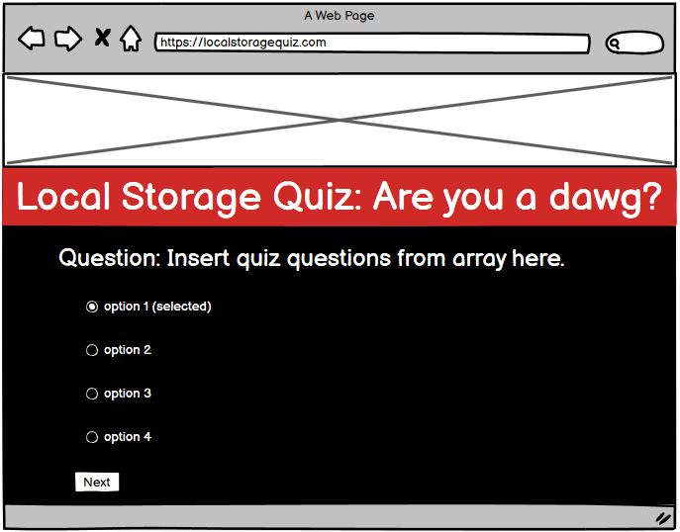
Application Mockups

Slide 5
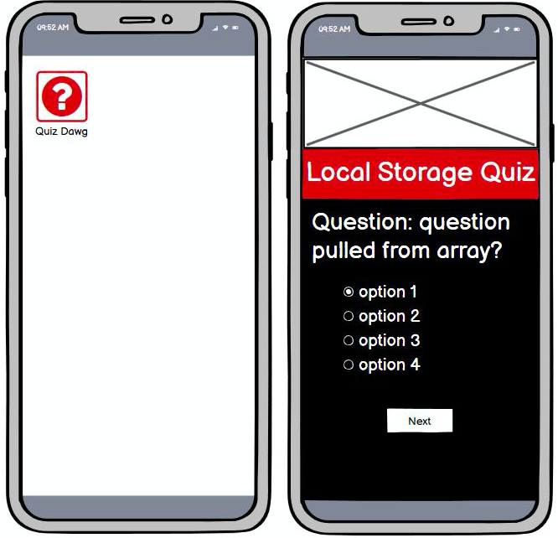
Mobile Mockups

Slide 6
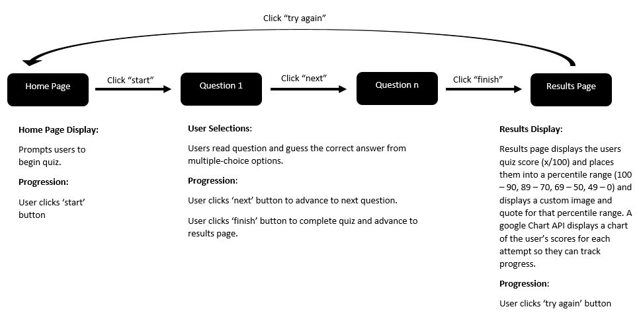
Project Work Flow

Slide 7
Challenges
-
Josh-JavaScript Code
Alex- HTML/CSS, ensuring HTML, CSS, and JS were mobile friendly
Del- CSS adhering to UGA’s Visual Style Guide
Todd- PowerPoint Design
Ross- Browser Testing
Mikhael- Presentation Write-up
Kent- GitHub setup

Slide 8
What would we do differently?
Add more questions to the quiz bank.
Add different question categories such as sports or general knowledge.
Create different difficulty levels
Add functionality that allows users to share their scores on social media

Slide 9
Add-ons for Future Iterations
Adding question categories
Entertainment
Sports
Current Events
Include audio effects
Pop-up clues
User input form functionality for question suggestions or problem reporting
Include visual effects to indicate which questions were answered correctly/incorrectly.
Browser compatibility
Mobile app

Slide 10
QUESTIONS?

